Slide 1

Module Four: Data, information, knowledge, and wisdom
CIS 303 – Prof. C. R. Johnson

Slide 2
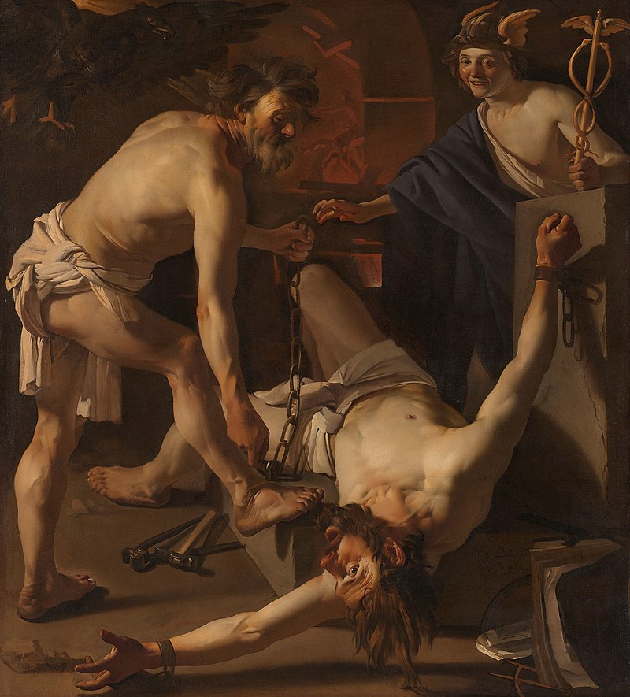
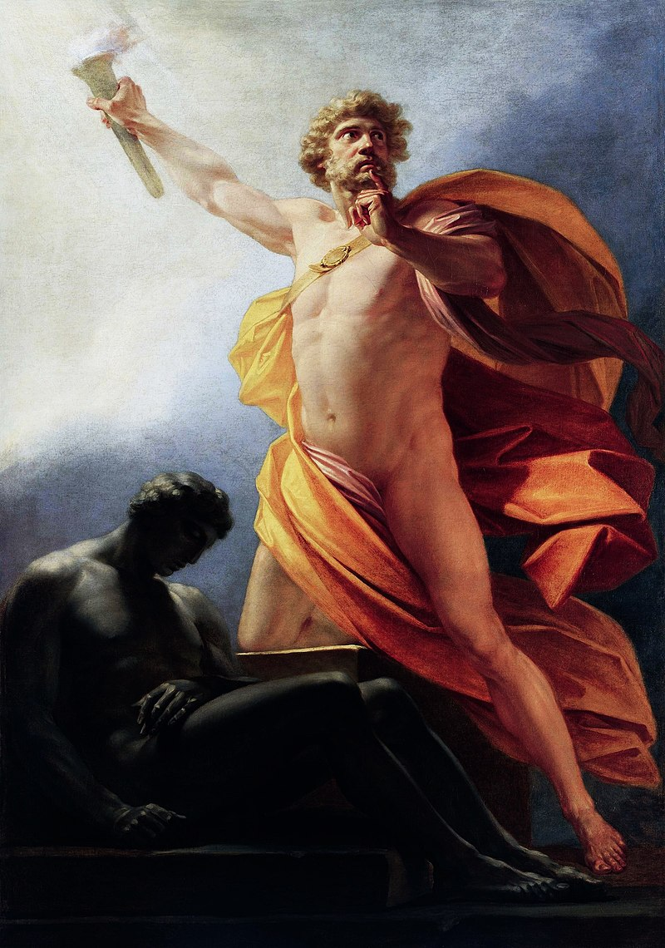
Playing
With
Fire

Slide 3
Socrates, on technology
“If men learn this, it will implant forgetfulness in their souls; they will cease to exercise memory because they rely on that which is written, calling things to remembrance no longer from within themselves, but by means of external marks. What you have discovered is a recipe not for memory, but for reminder. And it is no true wisdom that you offer your disciples, but only its semblance, for by telling them of many things without teaching them you will make them seem to know much, while for the most part they know nothing, and as men filled, not with wisdom, but with the conceit of wisdom, they will be a burden to their fellows.” – Socrates, according to Plato

Slide 4
Get off my lawn!
“A Google search is not the same as knowing something.” – Some boomer, probably.
Search engines act as gatekeepers to information.
Information IS agency.

Slide 5


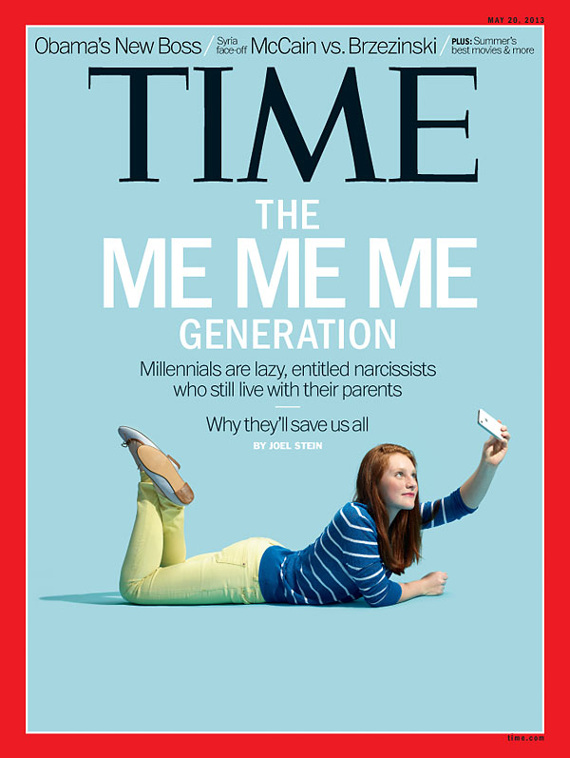
Get off my lawn!
“The children now love luxury; they have bad manners, contempt for authority; they show disrespect for elders and love chatter in place of exercise. Children are now tyrants, not the servants of their households. They no longer rise when elders enter the room. They contradict their parents, chatter before company, gobble up dainties at the table, cross their legs, and tyrannize their teachers.” – Socrates (not really)

Slide 6
How we know what we know that we know
Brave New World – Too much Information
1984 – Not enough information
“I have a foreboding of an America in my children's or grandchildren's time -- when the United States is a service and information economy; when nearly all the manufacturing industries have slipped away to other countries; when awesome technological powers are in the hands of a very few, and no one representing the public interest can even grasp the issues; when the people have lost the ability to set their own agendas or knowledgeably question those in authority; when, clutching our crystals and nervously consulting our horoscopes, our critical faculties in decline, unable to distinguish between what feels good and what's true, we slide, almost without noticing, back into superstition and darkness...
The dumbing down of American is most evident in the slow decay of substantive content in the enormously influential media, the 30 second sound bites (now down to 10 seconds or less), lowest common denominator programming, credulous presentations on pseudoscience and superstition, but especially a kind of celebration of ignorance” Carl Sagan, the Demon Haunted World

Slide 7
Intelligence is not a dump stat
Data eventually becomes information.
E = mc^2 was once based on data, but most people these days are familiar with the formula without even knowing what it really means.
Most of what we know is information in this way because of the methodology of public teaching – You learn things the teacher knows because you need to know them.
For those things you actually come to understand, it is more a function of you being interested than being taught to understand.

Slide 8
That’s how news works
News – broadly defined – is information-sharing between people. We have developed many ways of doing this. However, it is more than just convey current events.
News sets the agenda. We talk about what’s happening, and we know what’s happening because the news is reporting on it.
Our information-sharing network is self selected. CNN is news if we select it. Fox News, Buzzfeed, Vogue, Perez Hilton, various YouTubers, etc. if we choose it to be.
So, we decide who to follow, and our sources decide what’s important. There are competing incentives (coming up.)

Slide 9
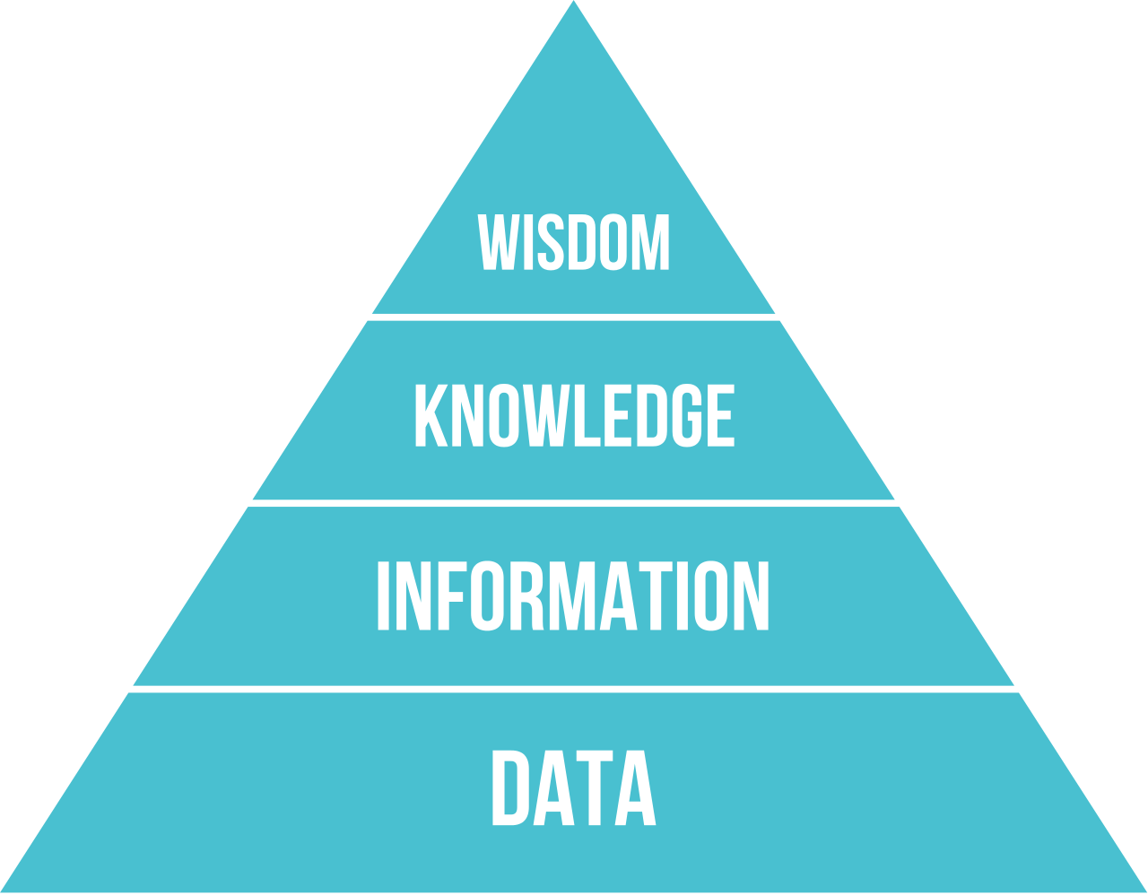
DIKW Pyramid
This is why data markets are so significant. You cannot gain the latter without the former, and the more you have the more potential it has.
Realizing this potential does not mean the evolution leads to sound judgement.

Slide 10
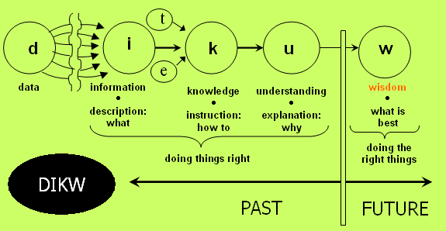

Slide 11
Information value
Information is a prerequisite to understanding – how much is understanding worth?
Perfect vs. imperfect information
Data with predictive qualities is the most valuable: Weight of Evidence = In(non-events / events)

Slide 12
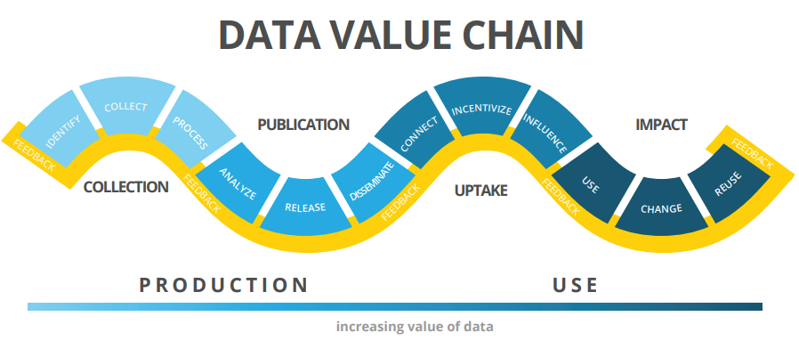

Slide 13
Example
Data:
12012014
Interpretation -> Information
ID number?
A date? MM/DD/YYYY or DD/MM/YYYY
Can’t be YYYY/MM/DD, right? Only if we assume it is a date format familiar to us. It is currently 4719 in the Chinese Calendar. 12023 in the Holocene. 1442 in Islamic. 2565 in Thai Solar
Interpretation adds CONTEXT and VALUE.

Slide 14
Data becomes Information
By combining data from multiple sets (aggregation)
Ensuring data is relevant and accurate (validation)
By exposing relationships between points (organization)
Who – What – When – Where

Slide 15
Data vs. Information
A compilation of sources and attributes on a topic.
A search engine indexes websites and compiles it along various markers in a search algorithm, so that when someone searches, they will receive relevant results.
Information denotes organized data about a topic that is obtained from any source.
News is information, but so are opinion columns and art – and discussions with others.

Slide 16
Information vs. knowledge
Processing information improves the presentation – making it easier to interpret it. Interpretation eases assimilation.
Assimilating information brings comprehension.
Knowledge is the awareness and understanding of the subject. It is refined from information by experience, intuition, and education.
Knowledge is necessary to formulate predictions and inferences. It is a cognitive process.

Slide 17
Why it matters
Conflating the ideas these terms describe can lead to critical fallacies.
Data is always correct. For example, an application cannot be on version 1.34 and 2.6 at the same time.
Information can be wrong. For example, previous intel indicated the application was version 1.34, but current intel says it is version 2.6.
Knowledge is used when we make the inference that the application as updated between collection of data points.

Slide 18
Why it matters
It is also important because of one final term – Wisdom.
We can know HOW (knowledge) but not know WHY (wisdom)
We can understand that we COULD and not whether we SHOULD
Data is organized into information. Information is necessary to knowledge. Knowledge leads to wisdom. Wisdom is judgement, shared understanding.

Slide 19
Intelligence is not a dump stat
Many industries, particularly cybersecurity, lives and dies by intel.
Intel is the interpretation of data into information and application to a topic.
Example – Datum is a single list of responses to a survey. Data is collecting and compiling those results. Information is a reflection of responses (this is what is happening.)
Intelligence/understanding an interpretation of those results indicating that ransomware is on the rise.
Knowledge is developing practical response and prevention measures (gathering data and intelligence in that process) in response to this threat.
Wisdom is learning lessons from outbreaks and improving practices as a result.

Slide 20
Making Data Useful
Productivity on an assembly line is measured before Christmas break and then after. Fewer units are assembled after than before. Data -> Interpretation.
Employees who get breaks work slower?
Employees work faster when they have a break coming up to look forward to?
It takes a while to ramp back up to capacity after a break?
Inefficiencies in operations create delays after a break?

Slide 21
What we do online
The Internet was originally more focused on communication.
There is now an intersectionality between communication and information seeking.
The Web is how we communicate, socialize, learn, engage with markets, access entertainment, contract services, the list goes on and on.

Slide 22
Fruit of a Poisoned Tree
Garbage in means garbage out.
It is difficult to identify inconsistencies / inaccuracies
It is difficult to reconcile cognitive dissonance

Slide 23
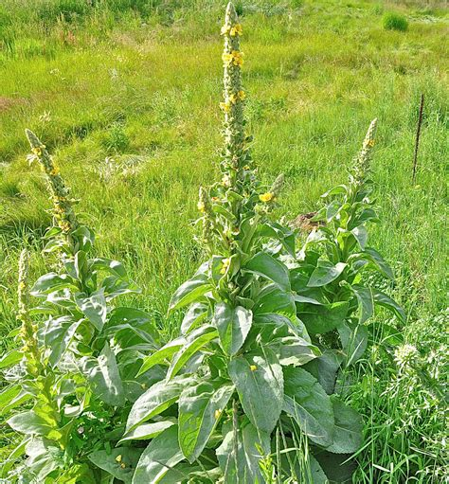


Slide 24
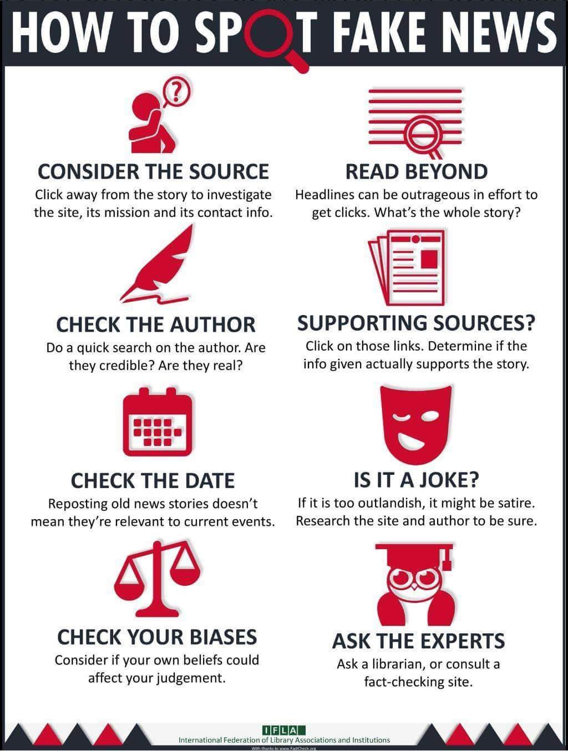
Problem
It takes a LOT of work to get the truth.
Information reinforces itself once it is accepted.
How do you KNOW what you KNOW?
News, Ads
Peers, Parents
Media, Influencers
You hear/see it

Slide 25
Misapplication
Social Media Algorithms:
The platform benefits from content that is popular – push that to the top.
The platform suffers from content that is unpopular – push that to the bottom.
The platform benefits from content that has a high level of interaction – push that to the top.
The platform suffers from content that is obscene or distasteful – push that to the bottom.
The platform benefits from content that pays for exposure – push that to the top.

Slide 26
It’s designed to bias
Radicalization pipelines
Pacing and leading
Information silos / echo chambers
FOMO
Amplifying popular / divisive content
Thought-terminating cliches (whataboutism, discounting, etc.)
Reinforcements (telling users they are the main character, or the only free thinkers left) – they are part of the “woke” or “red pill” or “based” crowd and everyone else is an unthinking sheep.

Slide 27
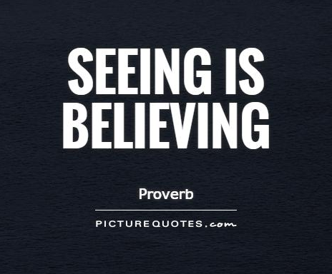
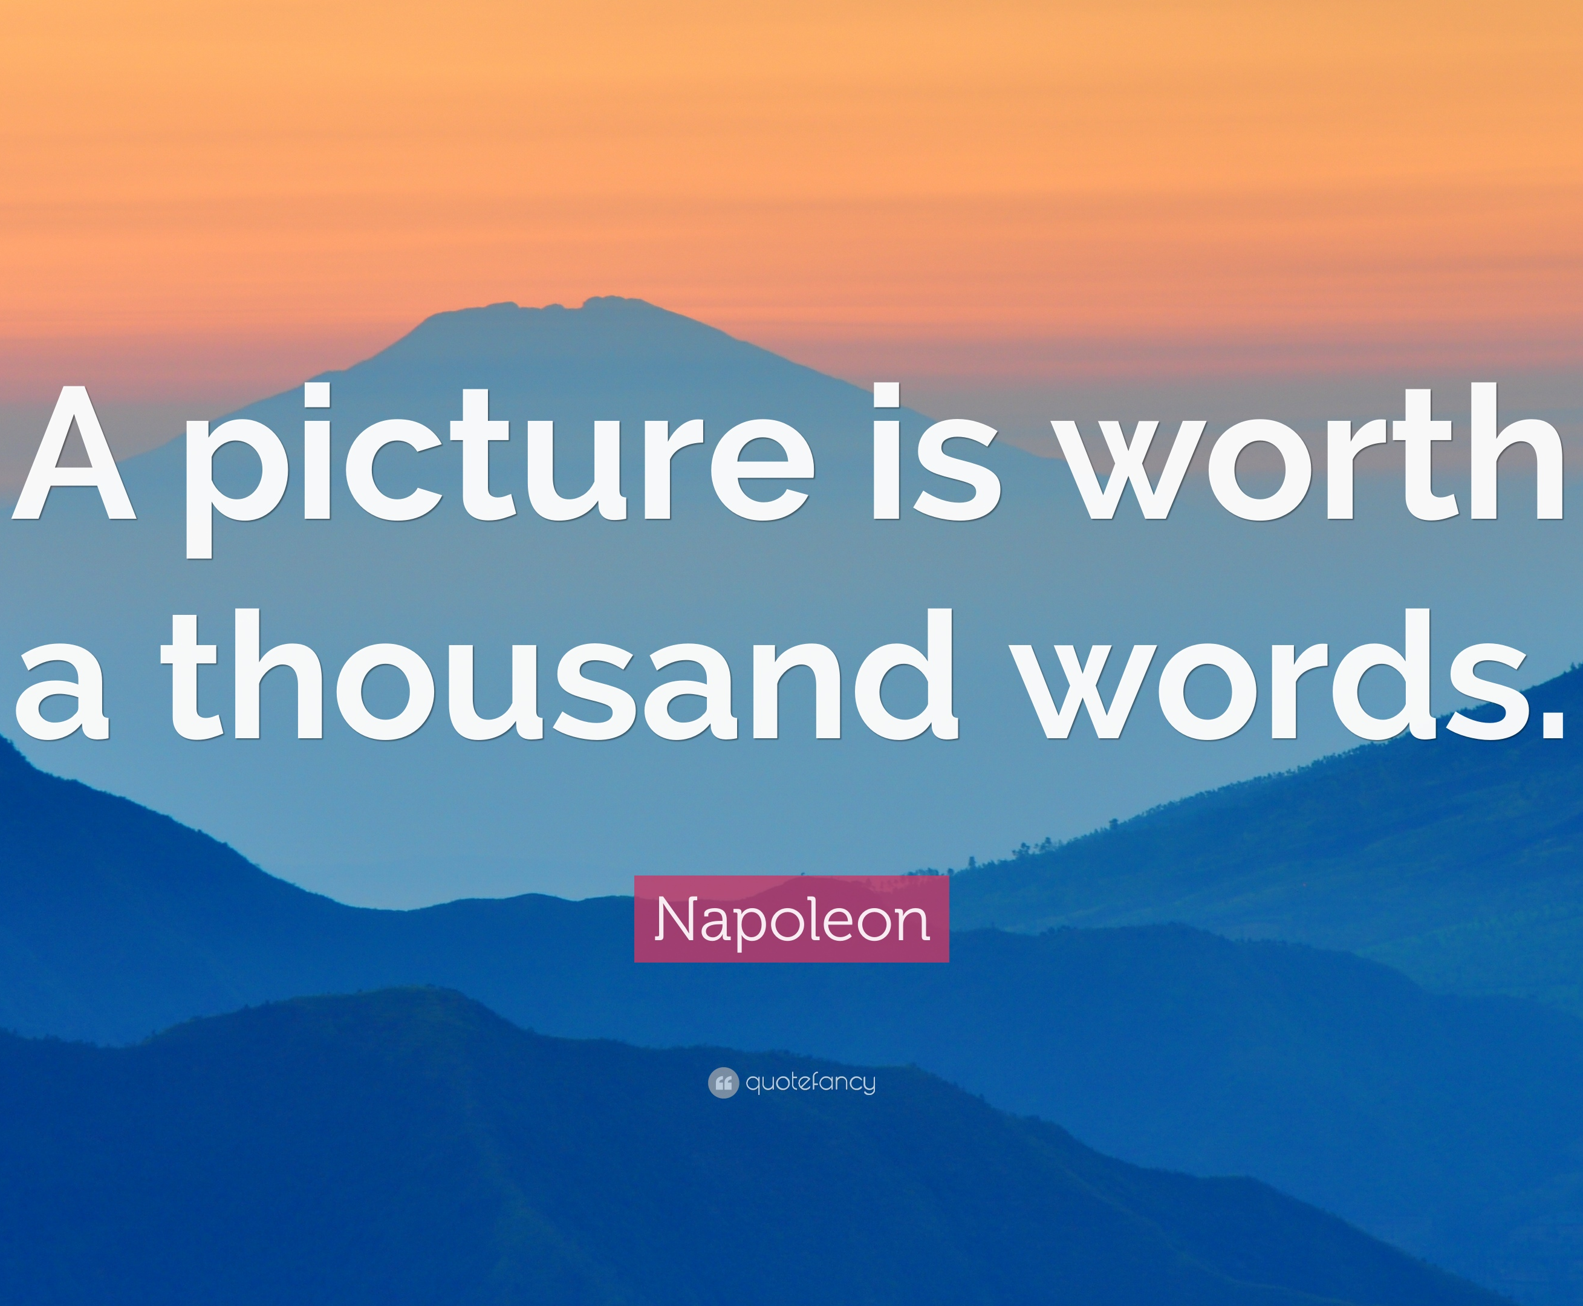
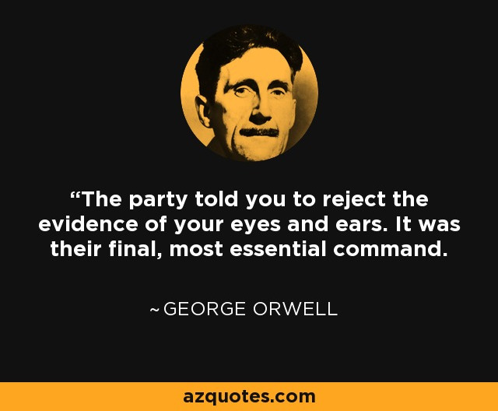
What we see and what we know

Slide 28
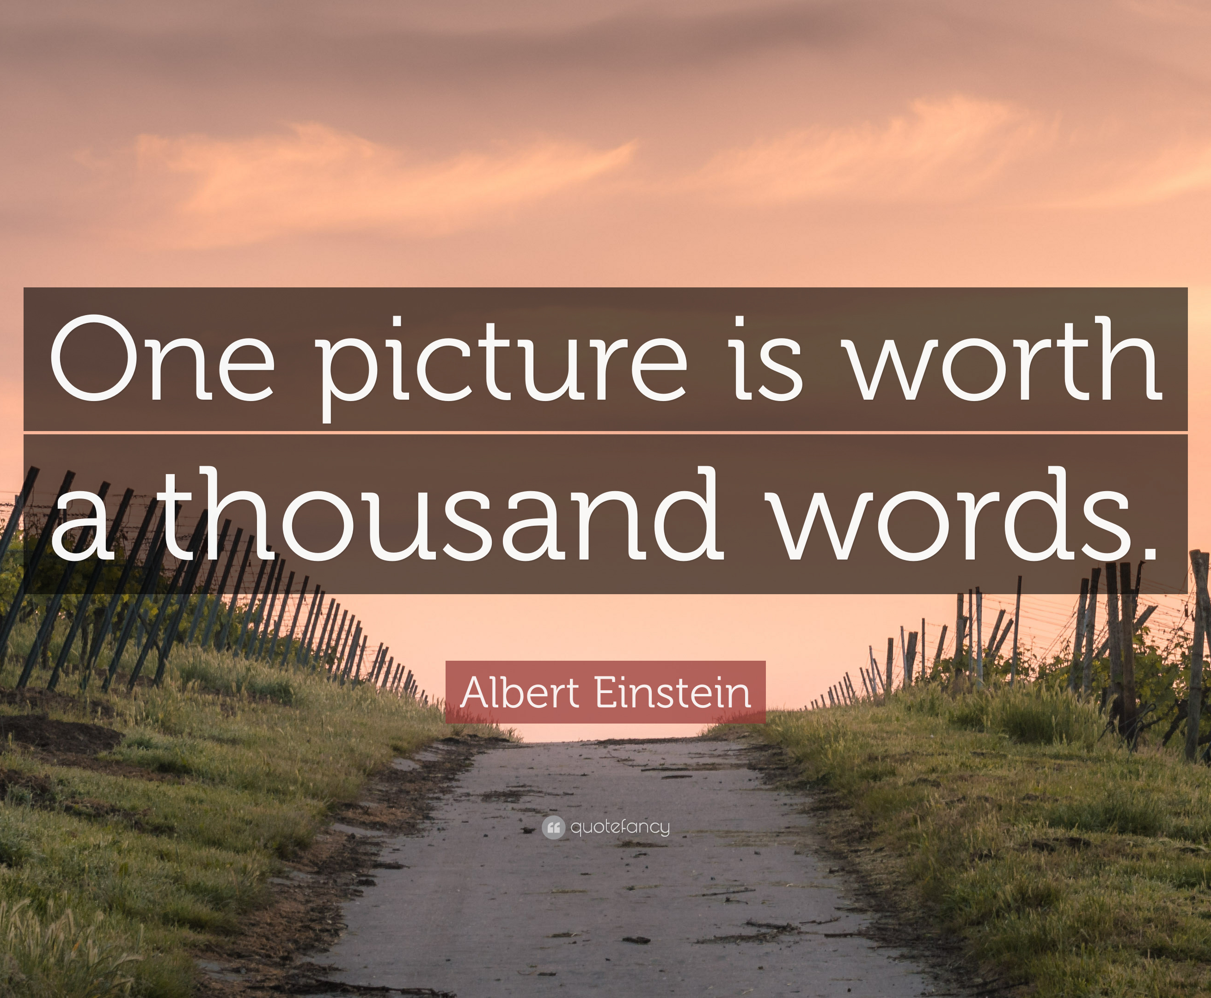
What we see and what we know
One picture is worth ten thousand words.
Frederick R. Barnard
“Printers’ Ink” 1927

Slide 29
Images in Communication
After text, still images are the most common form of expression online. Video is third.
Visual content invariably results in more engagement, greater reach, and less ephemerality (i.e. it is more “viral.”)
People are far more likely to store visual media offline in collections.
There are many incentives for forging images, and automated tools cannot outpace the technology that creates them.
Cooper, B., 2016. How Twitter’s Expanded Images Increase Clicks, Retweets & Favorites. Buffer Social Blog, April 27th, 2016.

Slide 30
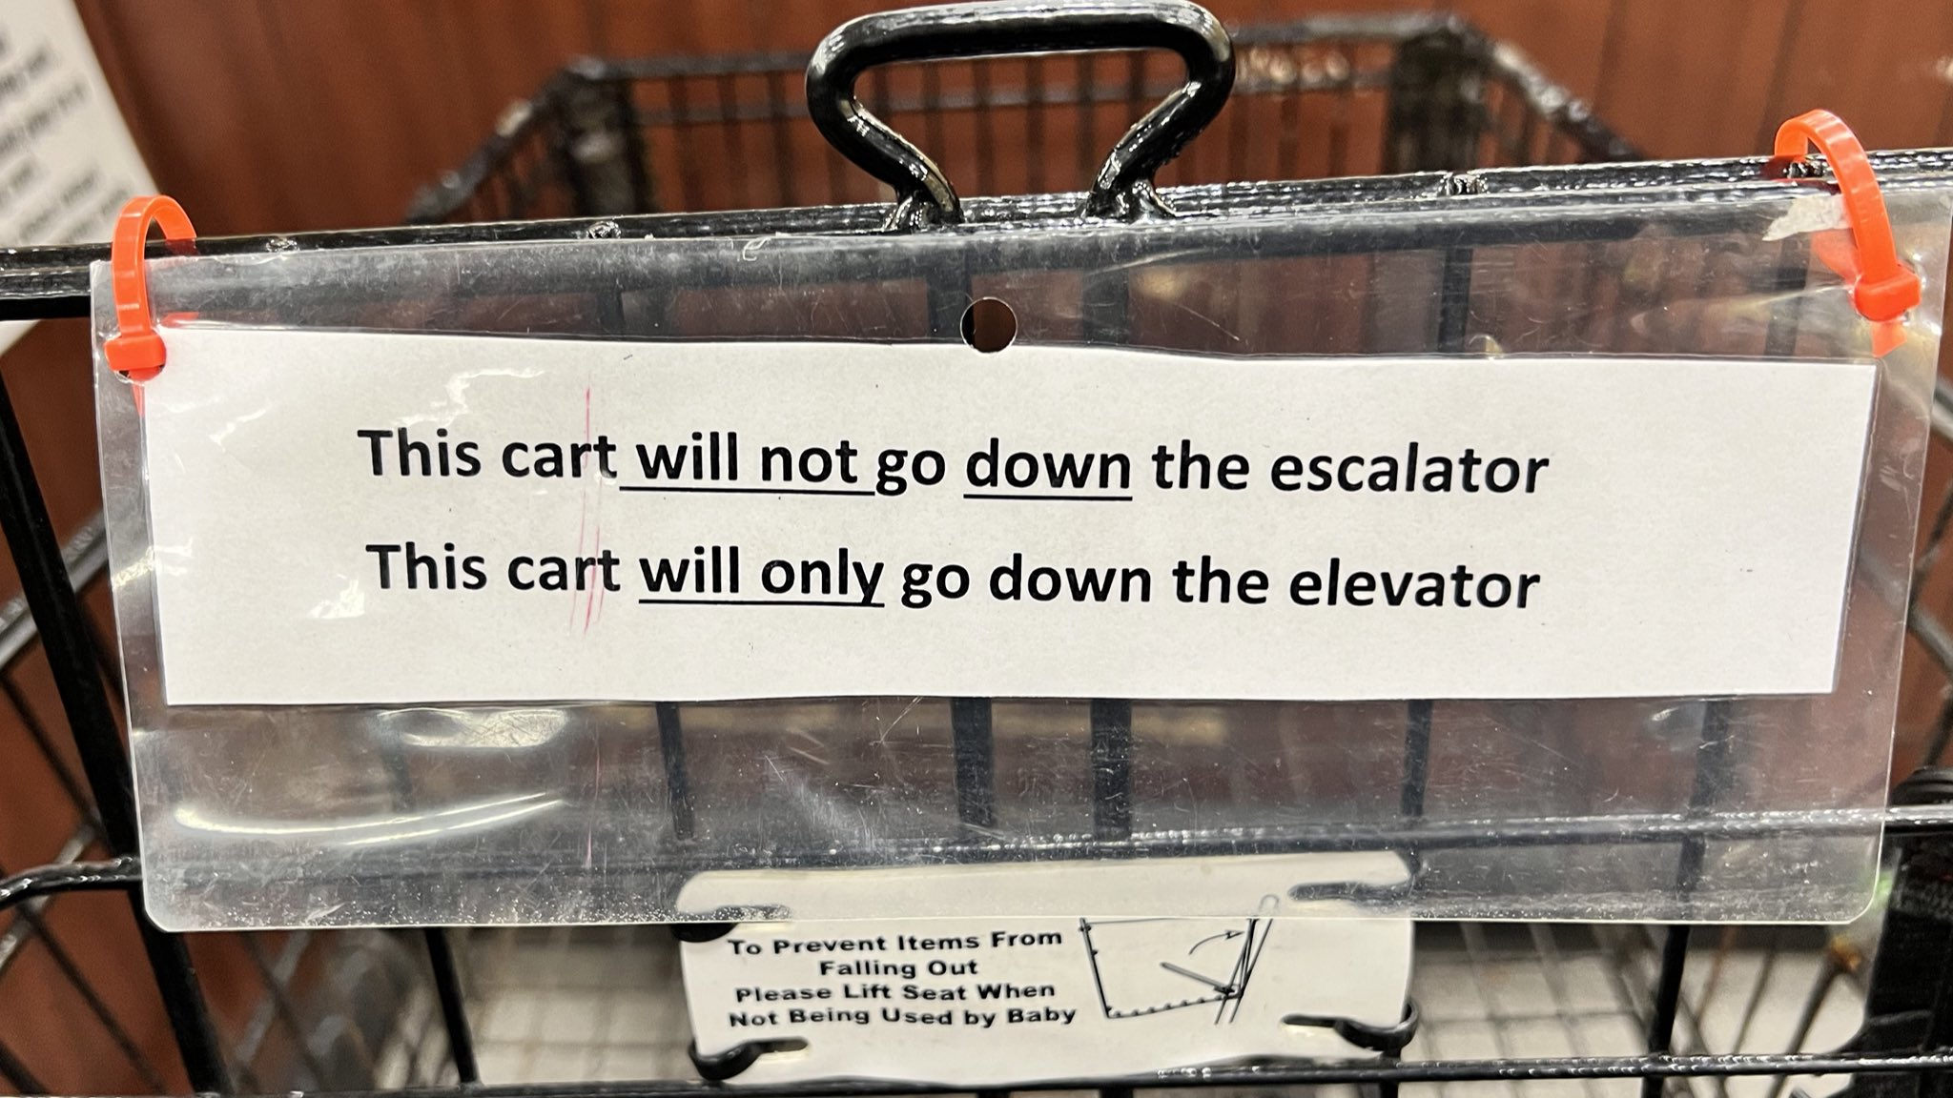

Slide 31
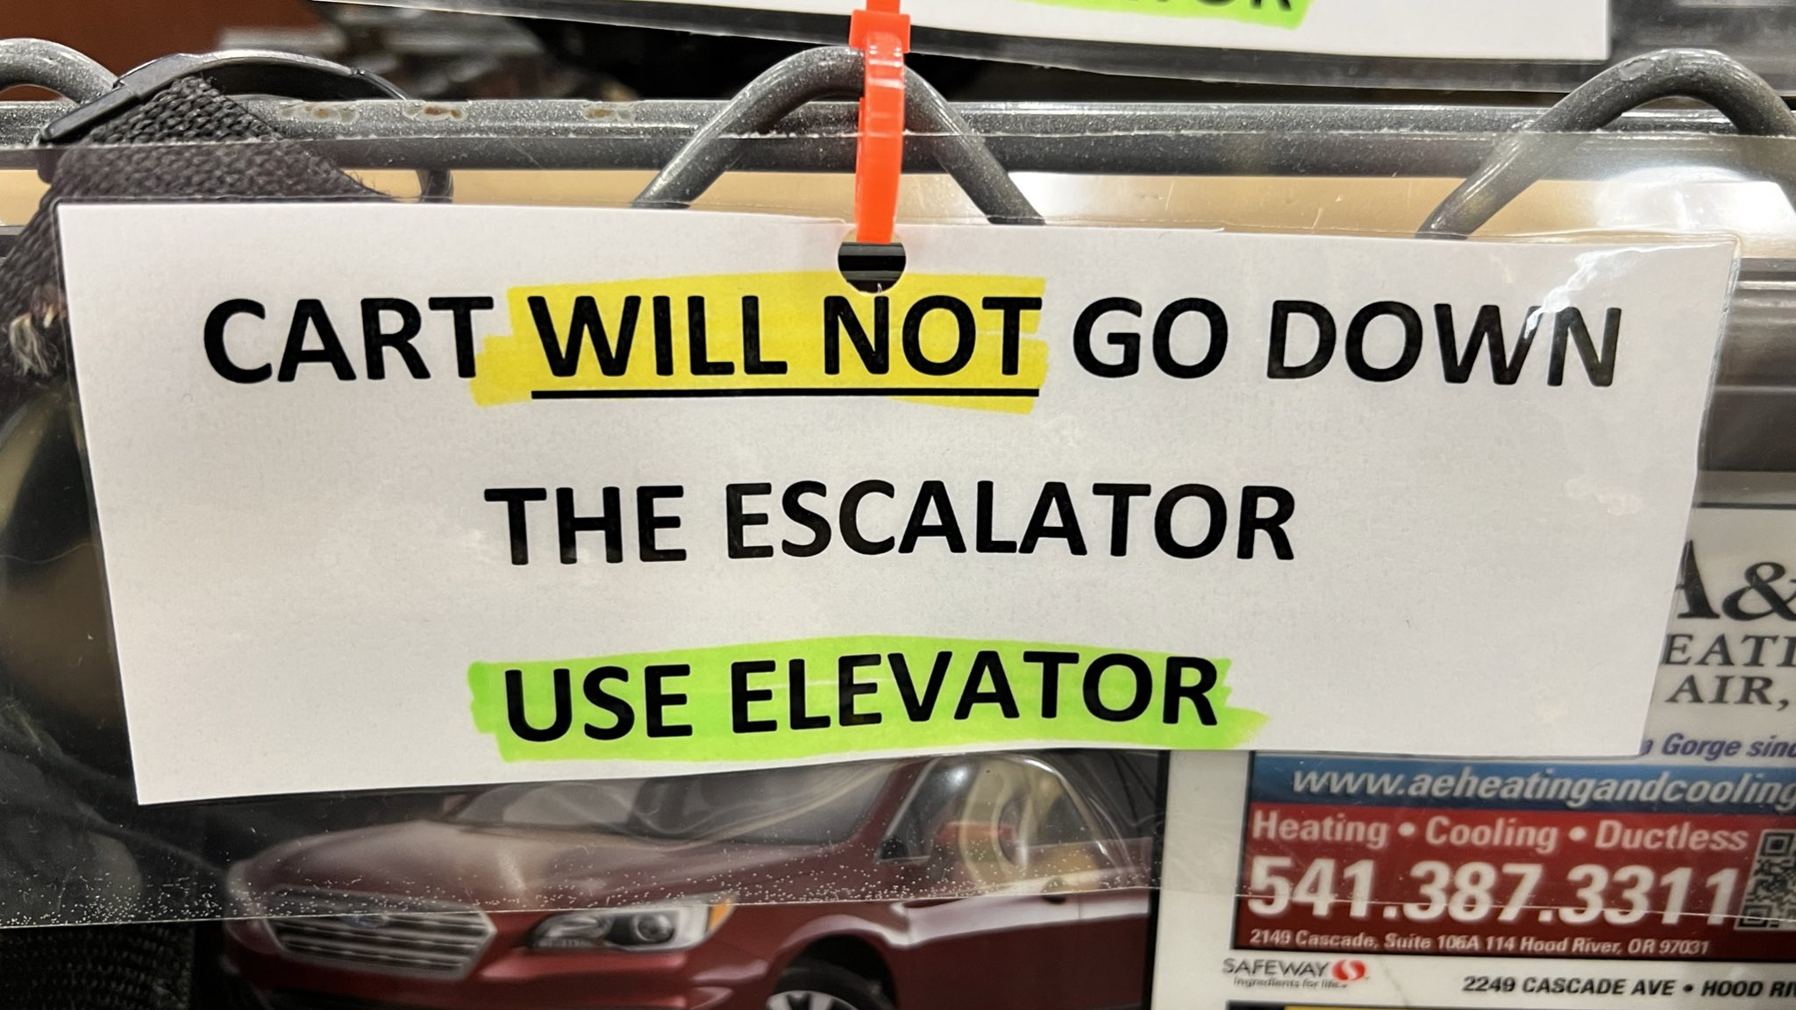

Slide 32
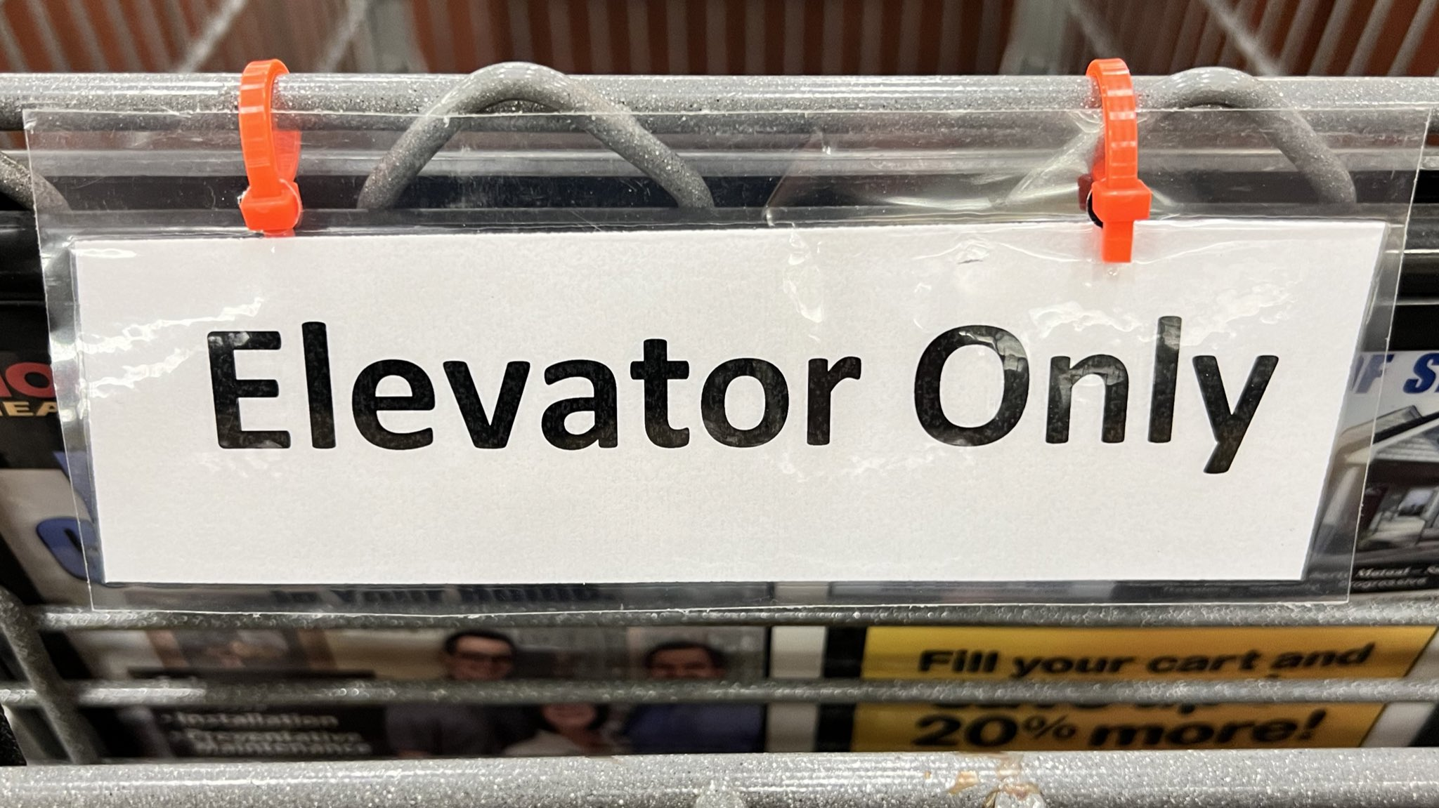

Slide 34
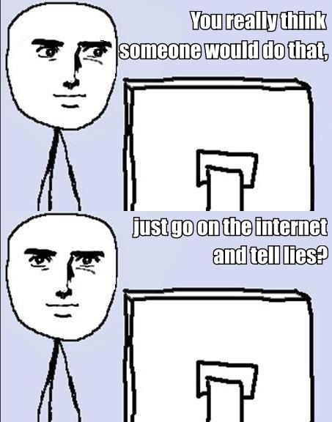
Misinformation
There’s a lot of reasons people would provide false information:
Financial / Ideological – Support interests, discredit competitors.
Amusement – Entertaining self/others.
Ignorance – Easy answers are easy.

Slide 35
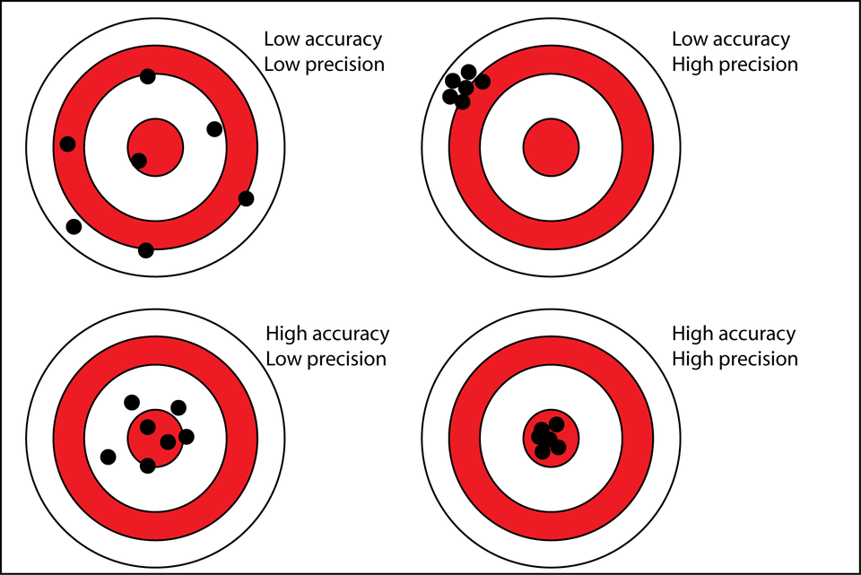
Inadvertent misinformation

Slide 36
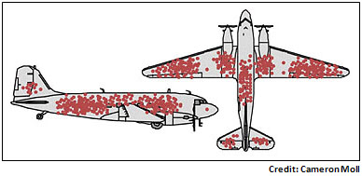
Misinterpretation

Slide 37
Data abuse
Discrimination
Predictive analytics, or breach of confidentiality used to defame or demean individuals.
Identity Theft
Exposure of personal information leading to financial losses or loss of public trust.
Loss of Anonymity
Exposure of data leads to re-identification or provided the basis for disambiguation.
Sovereign Exemptions
Government agencies collecting data with impunity, without governing law or public knowledge.
Data Brokerage
Big data markets engaged in selling data that is outdated, inaccurate, and/or unprotected.
Misinterpretation
Utilizing data with faulty methodologies or where the integrity has not been preserved. Collecting MORE data instead of high-quality data.

Slide 38
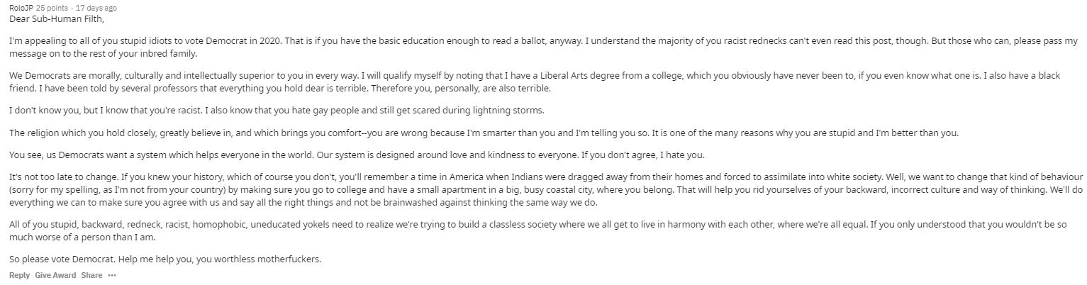
Misinformation

Slide 39
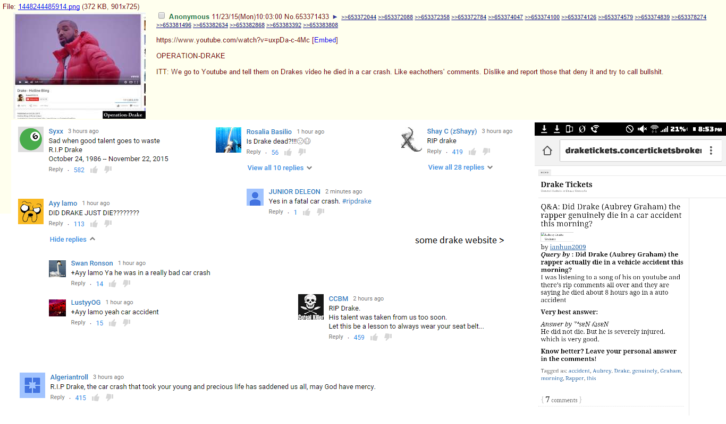
Misinformation

Slide 40
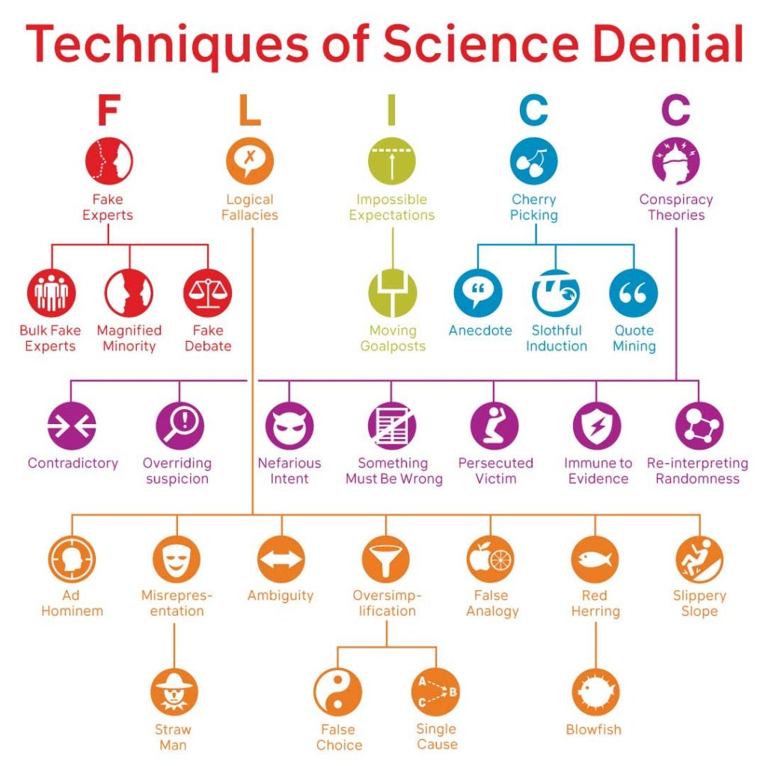
Misinformation
There’s a lot of reasons information in your organization might be misleading as well:
Incomplete information
Intentional sabotage
Misinformation/Misapplication

Slide 41
Everyone’s American
The Internet does not belong to the United States. The rights afforded to us as citizens does not extend to foreign nationals.
Still, we expect those rights to be honored regardless of where we are. For websites that reside in, or do business in, the United States, we expect those rights to be preserved.
We also cannot deny that this is the case – there have been many court cases in US jurisdictions that are decided on a Constitutional basis.
The way each nation relates to the Internet also matters and so the USA, being a big part of the Internet (though no longer the biggest) does have general influence over how the Internet operates, what’s acceptable, and what’s legal.

Slide 42
Internet Censorship
NOTE: The censorship of the Internet is not new. Throughout the 90s and 00s there have been multiple attempts to “sanitize” the Internet with various decency acts during various times of moral panic.
They have generally gotten nowhere thanks largely to the structure of the Internet in general (to censor the Internet is to censor thought.)
HOWEVER – the newest Net Neutrality arguments are gaining a lot more ground because it is not being done under the guise of censorship but under the direction of market forces.
It’s not “censorship” it’s “content filtering” or “content categorization”

Slide 43
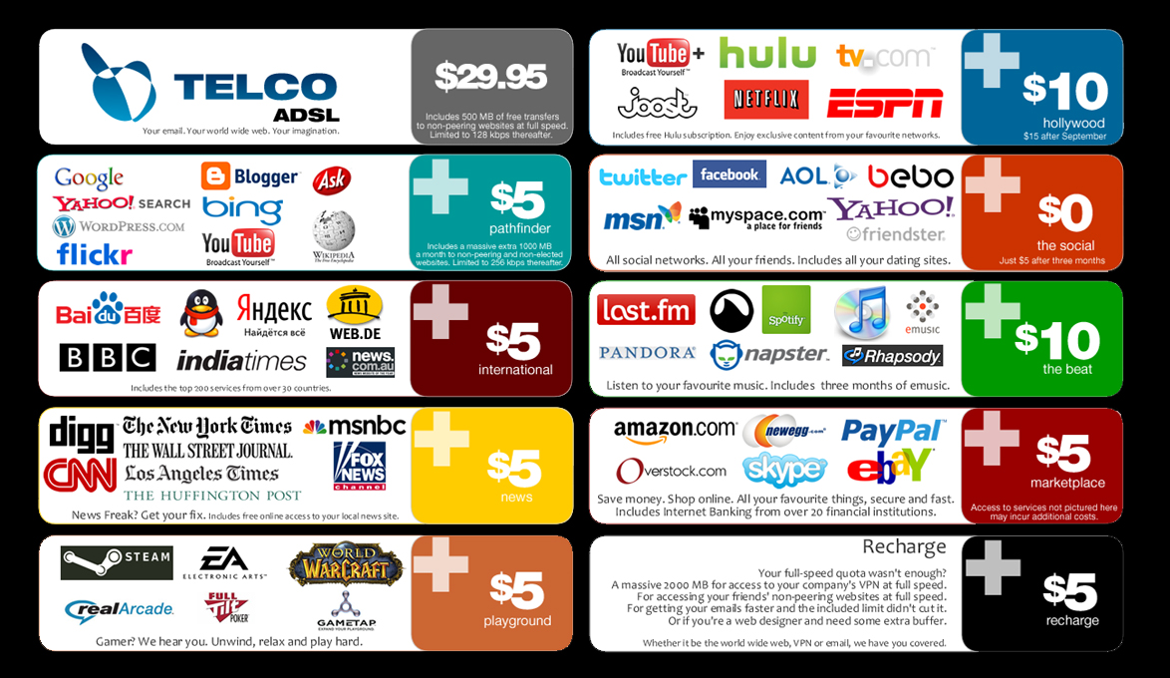

Slide 44
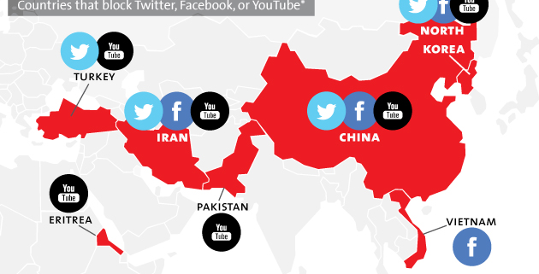

Slide 45
The Limits of Free Speech
The first amendment does not provide an apple box to shout from, nor obligate anyone to listen to them.
The first amendment does not give you the right to violate personal property.
This is part of the net neutrality argument. If the Internet is business, then business are private and your civil rights to freedom of expression do no apply to private property.

